Slide 1
Robot Vision
Michael Lai

Slide 2
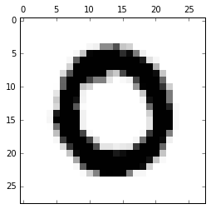
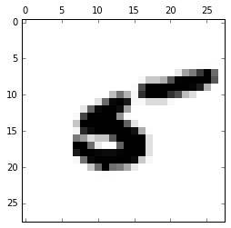
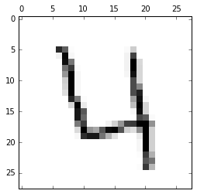
Goal
Predict Numbers ~ Consider Speed and Accuracy

Slide 3
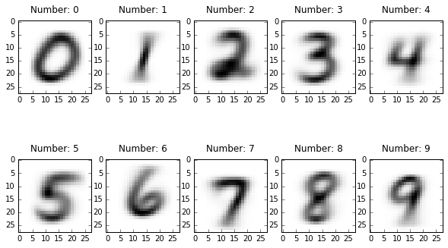
Data Details
MNIST Data Set
42,000 Images
Handwritten
Labeled 0-9

Slide 4
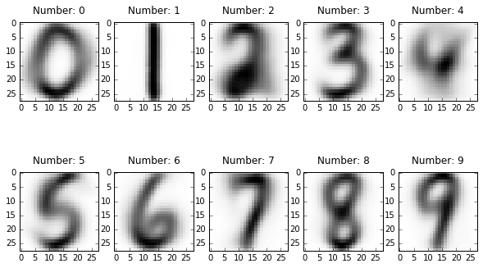
Methods: K Nearest Neighbors
Pros
Fast Training
Transparent
Cons
Pre-Processing
Rotation
Bounding Box
Accuracy (97%)

Slide 5
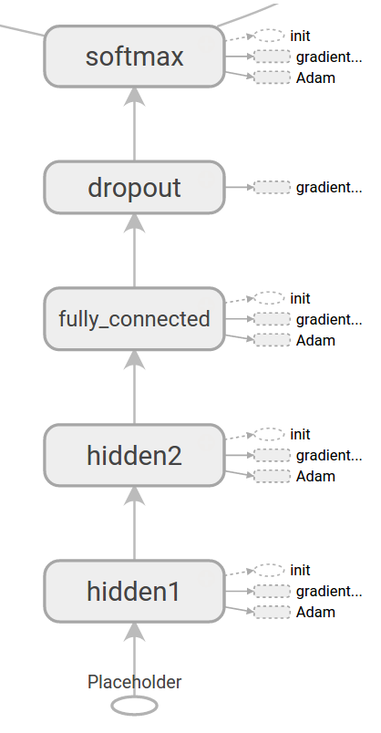
Methods: Convolutional Neural Network
Pros
Accuracy (99+%)
Cons
Less Transparent
Slow Training

Slide 6
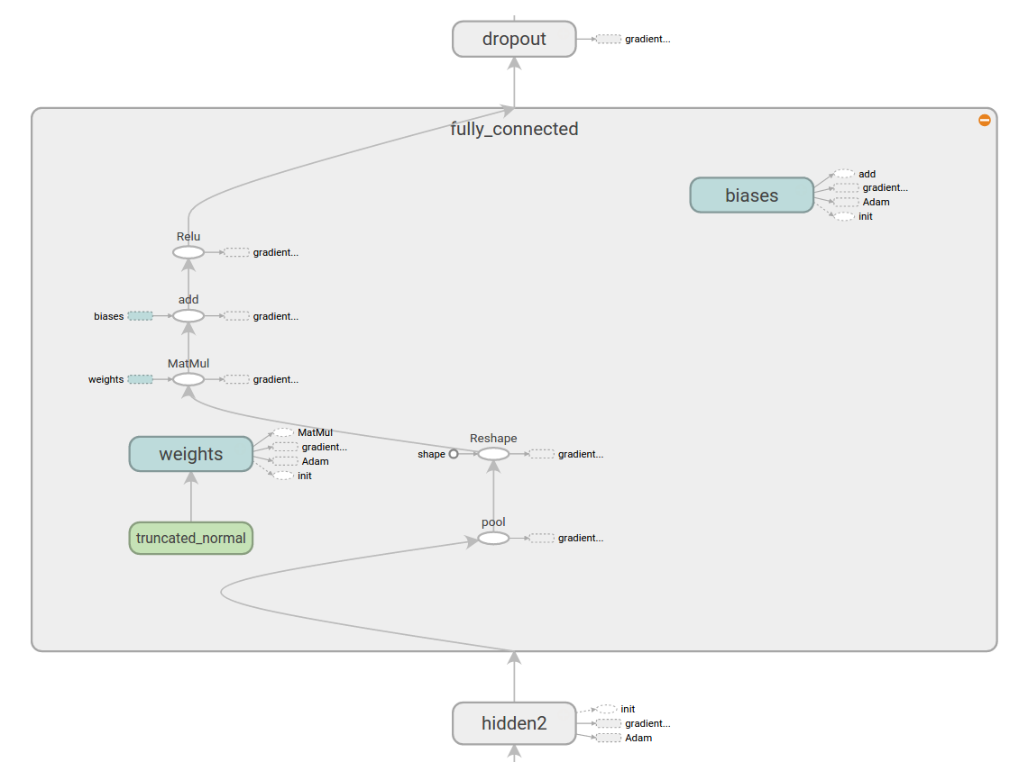
Methods: Convolutional Neural Network
Pros
Accuracy (99+%)
Cons
Less Transparent
Slow Training

Slide 7
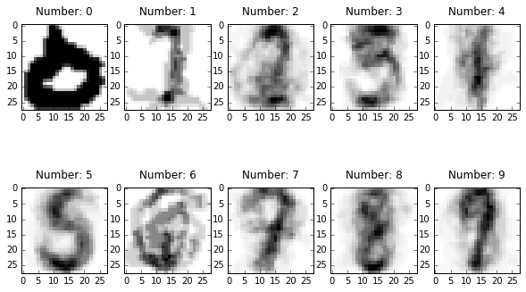
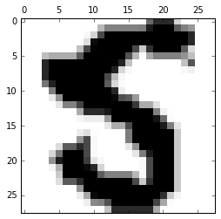
Results: K Nearest Neighbors
Actually: 5 Predicted: 6
Overall Accuracy 97%

Slide 8
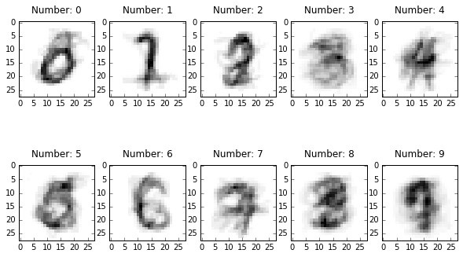
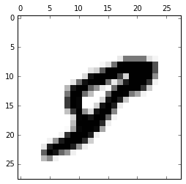
Results: Convolutional Neural Network
Actually: 8 Predicted: 9
Overall Accuracy 99%

Slide 9
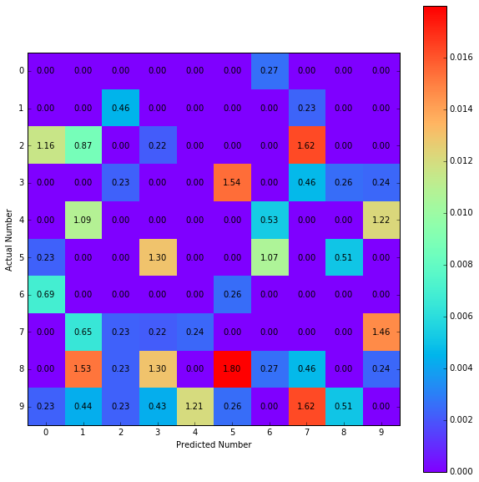
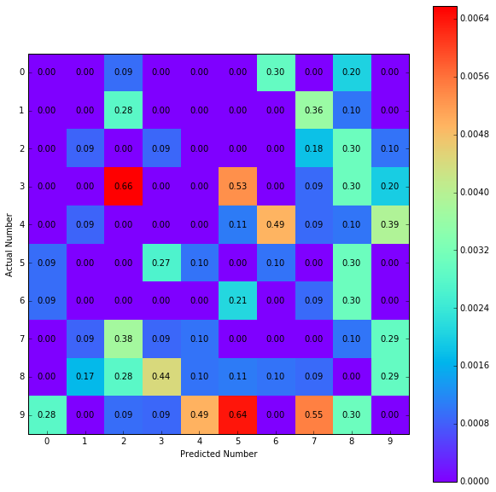
Results: Confusion
K Nearest Neighbors
Convolutional Neural Network

Slide 10
Recommendation
Use Neural Networks
99% Accuracy
66% Better Accuracy Than KNN
Quick Prediction Speed

